Slide 2

Welcome

Slide 3
Jedi Calcs: The Calcs Awaken
#Data17
Fearghal Gunning
Sr. Product Consultant
Nelson Norsworthy
Associate Sales Consultant

Slide 4
Agenda
Class Format
Challenges
Cohort Analysis
Table Calculations
Blending Challenge
Dashboarding Challenges
Grand Totals Challenge

Slide 5
Cohort Analysis

Slide 6
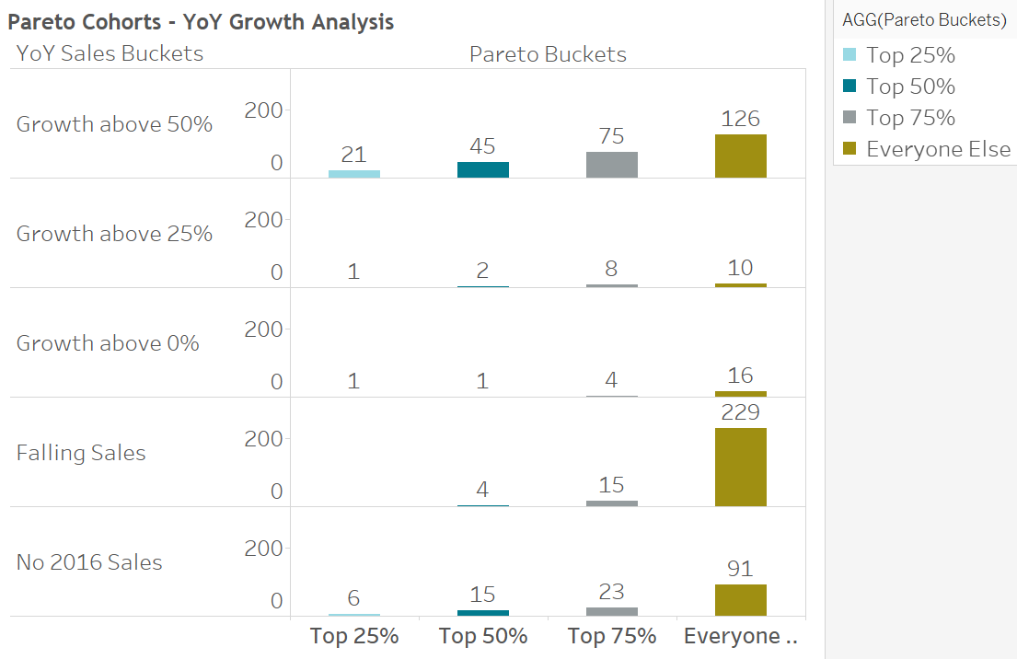
Pareto Cohorts – YoY Growth Analysis

Slide 7
Tips and Tricks
Table Calcs
-Secondary Table Calcs
-Sort on dimension
Cohort Calcs
LOD for unfiltered results
Reference Line Labels

Slide 8
Table Calculation

Slide 9
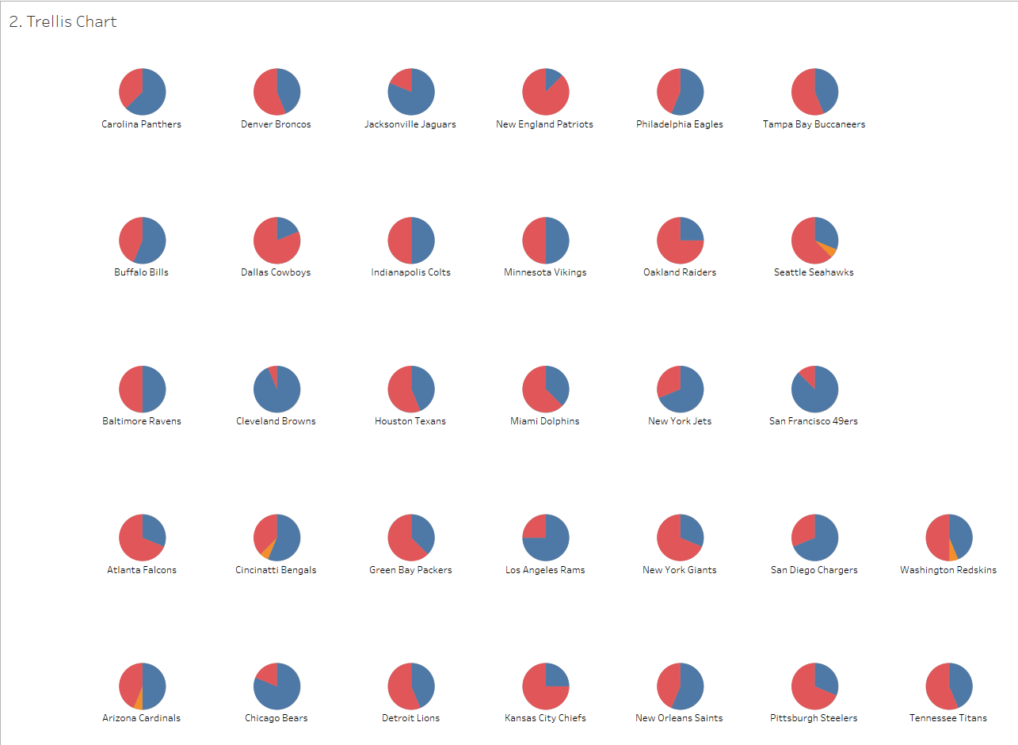
Trellis Chart

Slide 10
Tips and Tricks
LODs vs Table Calcs
Modulo
Compute Using…

Slide 11
Blending

Slide 12
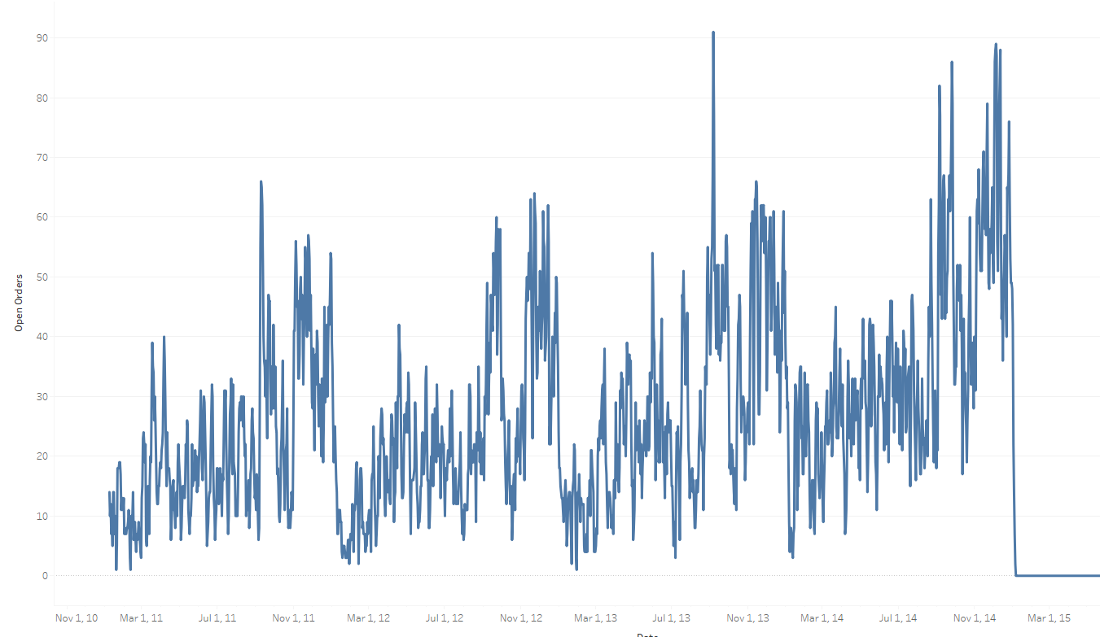
Open Orders

Slide 13
Tips and Tricks
“Complete” date tables
Performance

Slide 14
Dashboarding

Slide 15
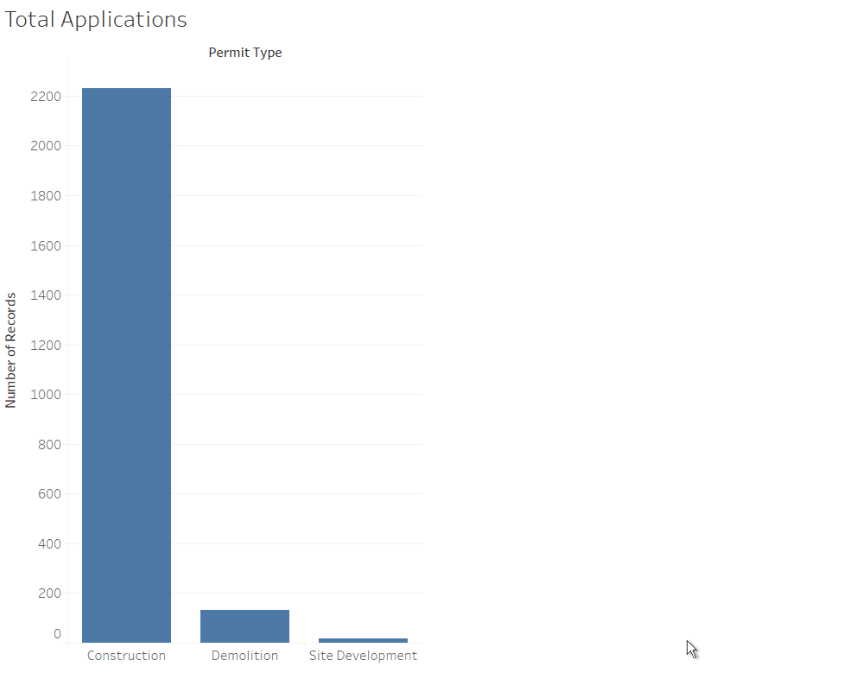
Open Orders

Slide 16
Tips and Tricks
Why duplicate fields?
When would you use this?

Slide 17
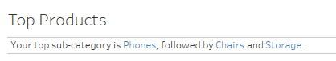
Top 3 Items…in a Sentence

Slide 18
Tips and Tricks
“Isolate and Propagate”
Performance Tips
String Aggregations
Top N Filters

Slide 19
Totals

Slide 20
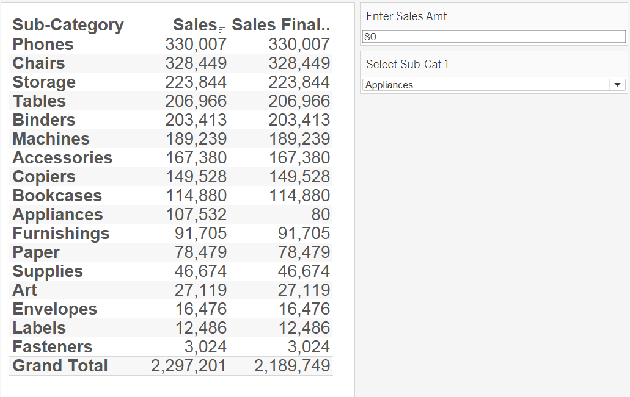
Custom Totals

Slide 21
Tips and Tricks
Size()=0 to adjust grand totals
Aggregated vs non-aggregated summation for totals

Slide 22
SESSION REPEATS
Day of Week, Month Day Session Title
Time – Time | Location
Day of Week, Month Day Session Title
Time – Time | Location
Day of Week, Month Day Session Title
Time – Time | Location

Slide 23
RELATED SESSIONS
Friday, October 23 Beginning Your Geographic Analysis Journey
11:30am – 12:30pm | Location
Friday, October 23 Beginning Your Geographic Analysis Journey
11:30am – 12:30pm | Location
Friday, October 23 Beginning Your Geographic Analysis Journey
11:30am – 12:30pm | Location

Slide 24
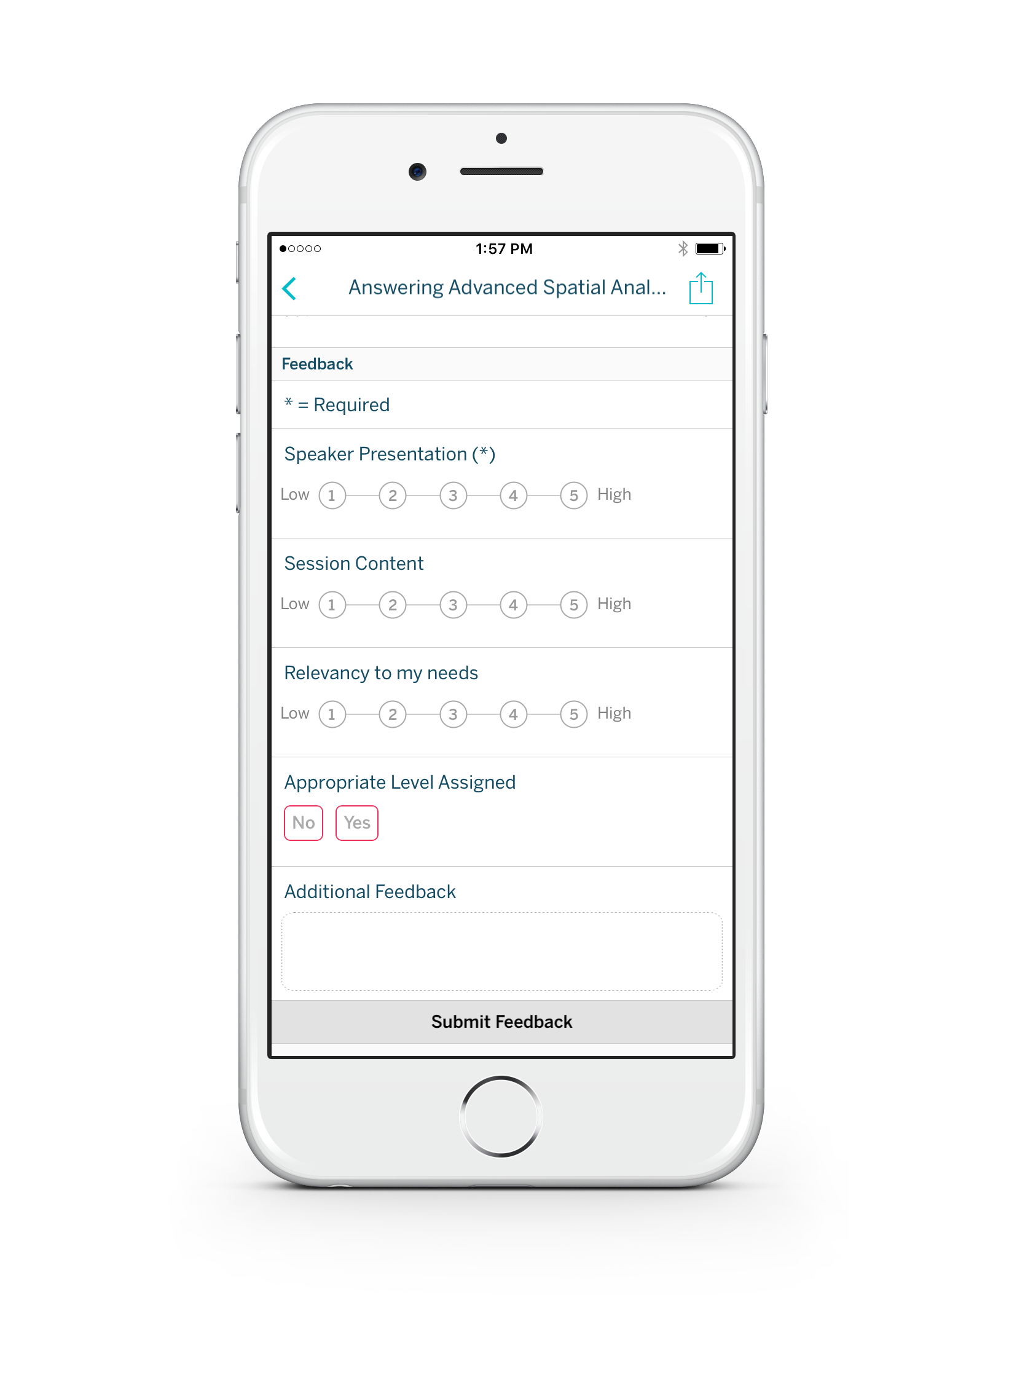
Please complete the session survey from the Session Details screen in your TC17 app

